Slide 1

Face recognition using alexnet
Nabil Kana

Slide 2
Introduction:
In this project, we fine-tune a pre-trained AlexNet model for face recognition by experimenting with different sets of hyperparameters. Top-performing models are aggregated to create a stronger, more generalized feature extractor. Statistical tools and feature vectors derived from these models are used to evaluate performance and build a scalable face recognition system.

Slide 3
Dataset and processing:
After downloading the AT&T Face Dataset, which contains images of 50 subjects with 15 facial images per subject. The model was fine-tuned five separate times, each using a different set of hyperparameters to explore how training configurations affect recognition performance. For every training session, 7 images per subject were used for training and 3 for validation. This iterative training process aimed to identify the most effective model setup for extracting discriminative facial features.

Slide 4
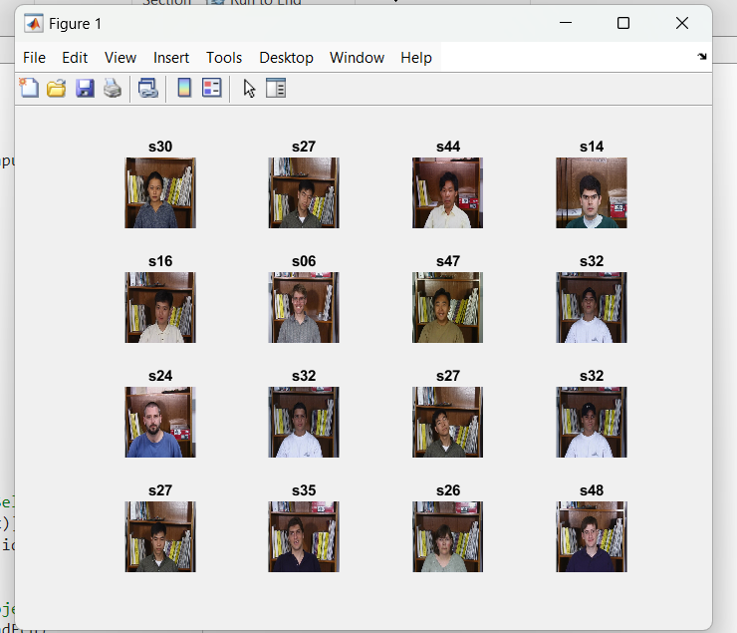
Sample images from the AT&T Face Dataset used in training

Slide 5
Training progress :
After training the AlexNet model six times with different hyperparameter configurations, we obtained the following results:
Accuracy and loss were evaluated for each model : Models trained on 50 subjects (Models 1–6) exhibited varied performance based on the chosen hyperparameters.
Top performing Models (those with accuracy ≥90%) were selected for further analysis and aggregation.
The plots below show the training progress (accuracy and loss) for each model. The goal was to identify the configurations that resulted in the best-performing models.

Slide 6
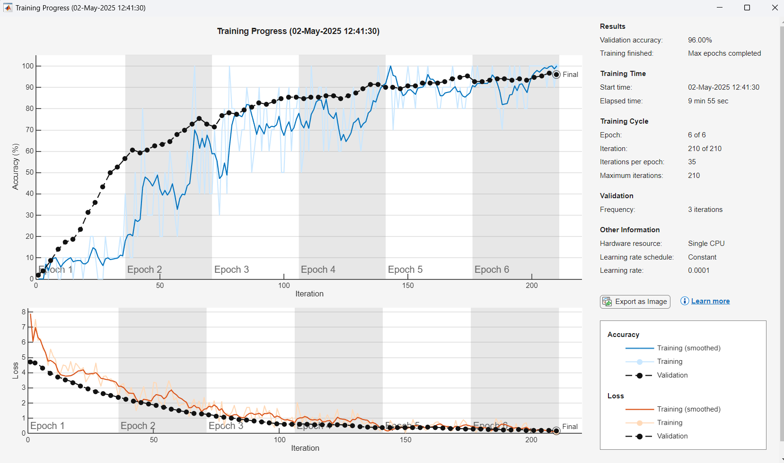
Training loss and accuracy for Model 1A

Slide 7
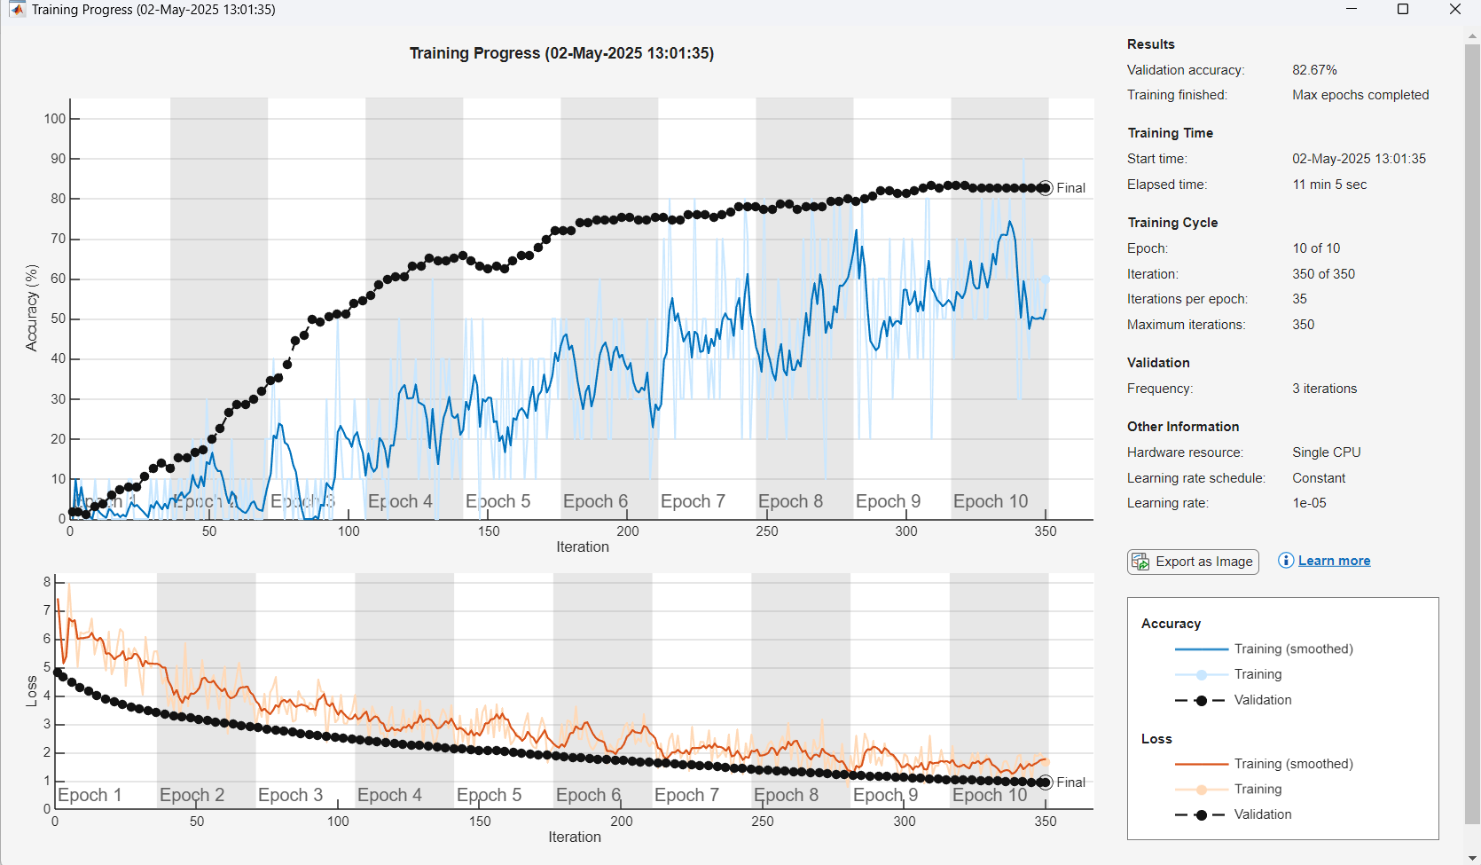
Training loss and accuracy for Model 2A

Slide 8
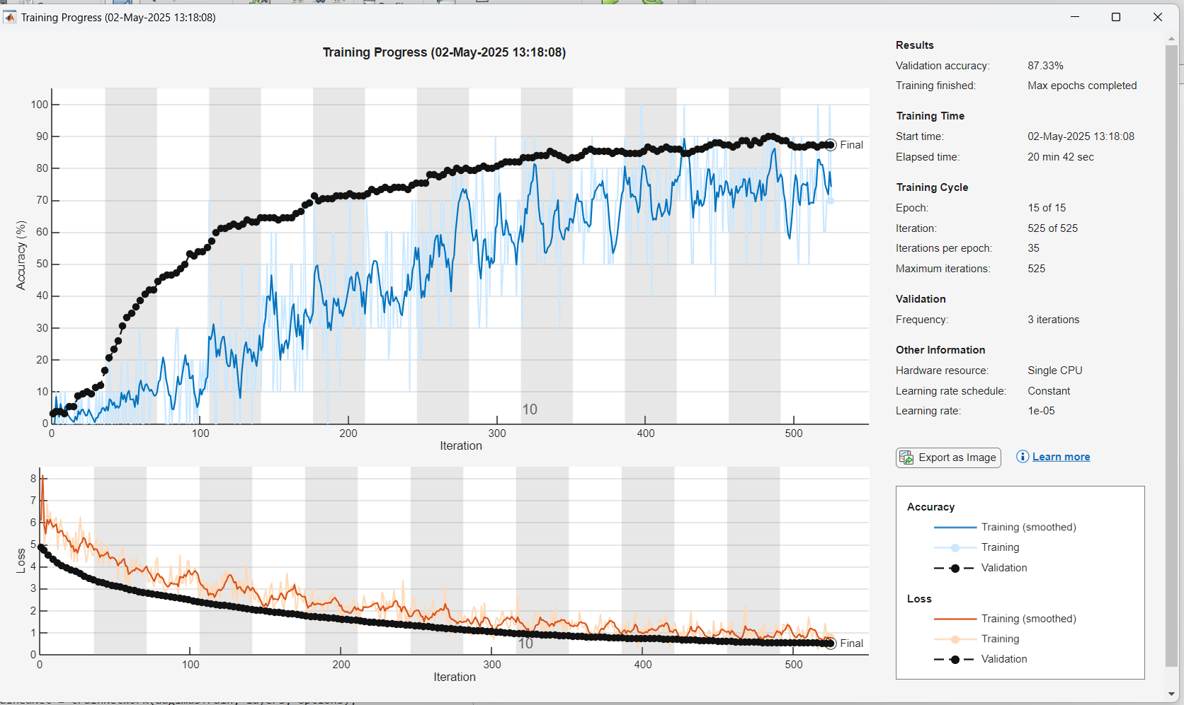
Training loss and accuracy for Model 3A

Slide 9
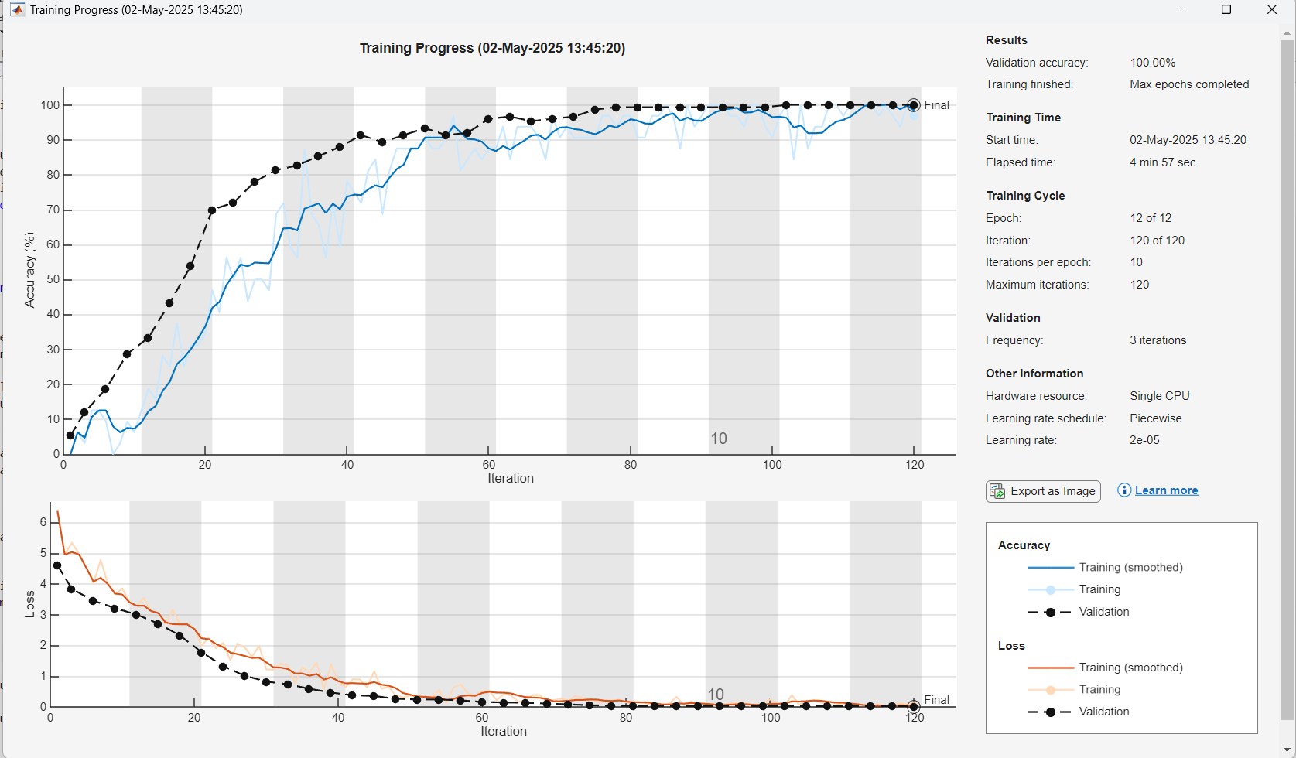
Training loss and accuracy for Model 4A

Slide 10
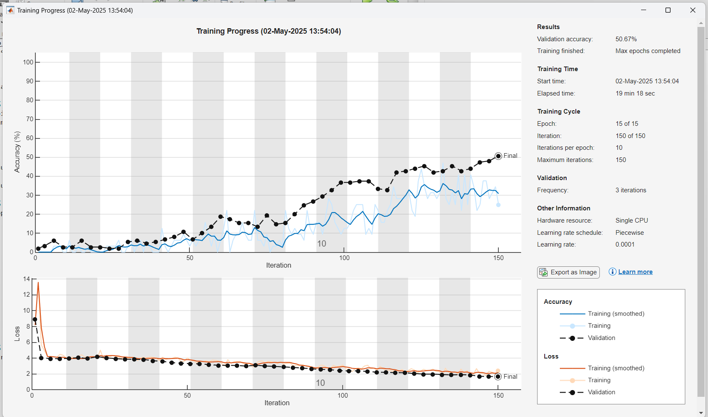
Training loss and accuracy for Model 5A

Slide 11
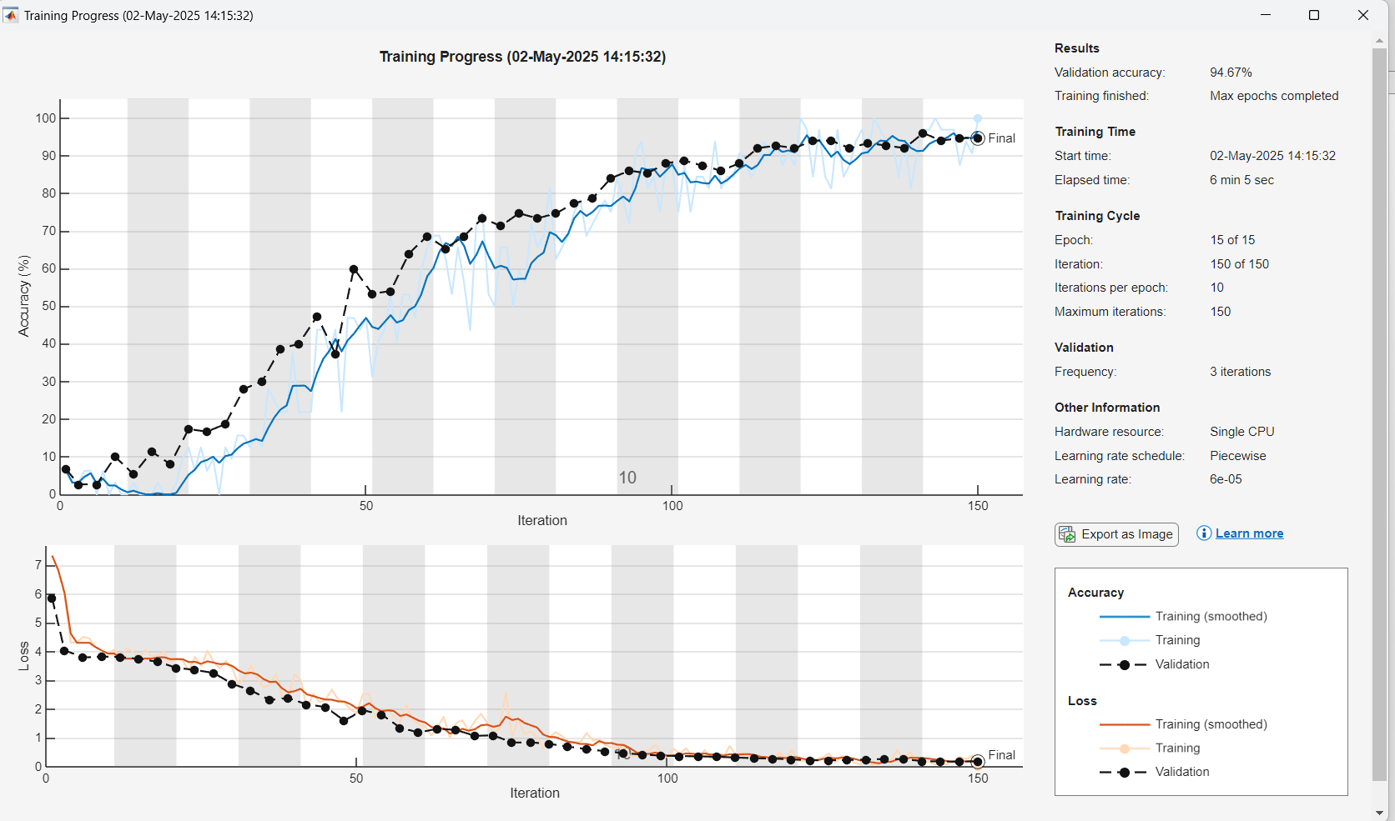
Training loss and accuracy for Model 6A

Slide 12
Model Selection and Aggregation:
After evaluating the six trained models, we discarded the three models with accuracy less than 90%. The remaining three models, which showed an accuracy higher than 90% were selected for further aggregation. The weights of the three selected models were averaged layer by layer to create a new, unified model. Before evaluation, we removed the classification layer from the aggregated model, using the output of the final fully connected layer (FC7) as a 4096 dimensional feature vector . These feature vectors were used to measure similarity between face images using cosine similarity.
The 11th image of each subject was used as a probe. The 12th to 15th images of all 50 subjects were used as a gallery. Cosine similarity was computed between each probe and every gallery image.
the ROC and distributions are as follows :

Slide 13
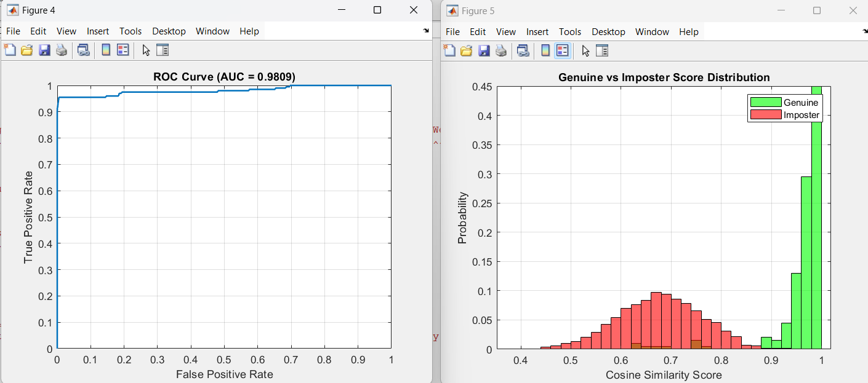
ROC curve and distribution histograms for the aggregated model A

Slide 14
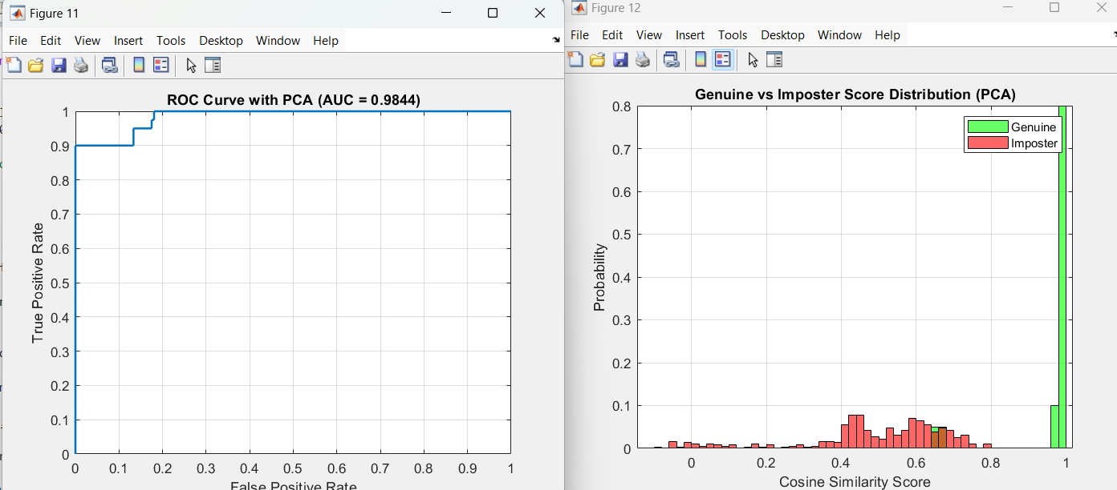
ROC curve and distribution histograms for the aggregated modelA after PCA with 90% of accumulated variance

Slide 15
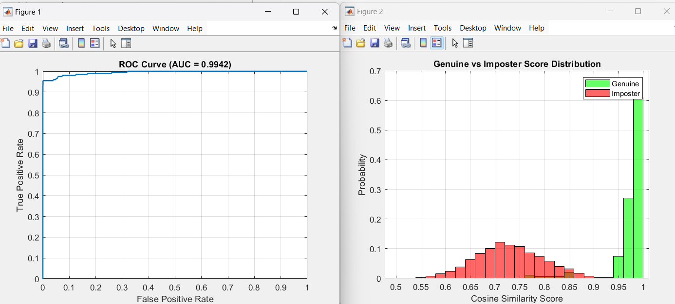
ROC curve and distribution histograms for the model 4A

Slide 16
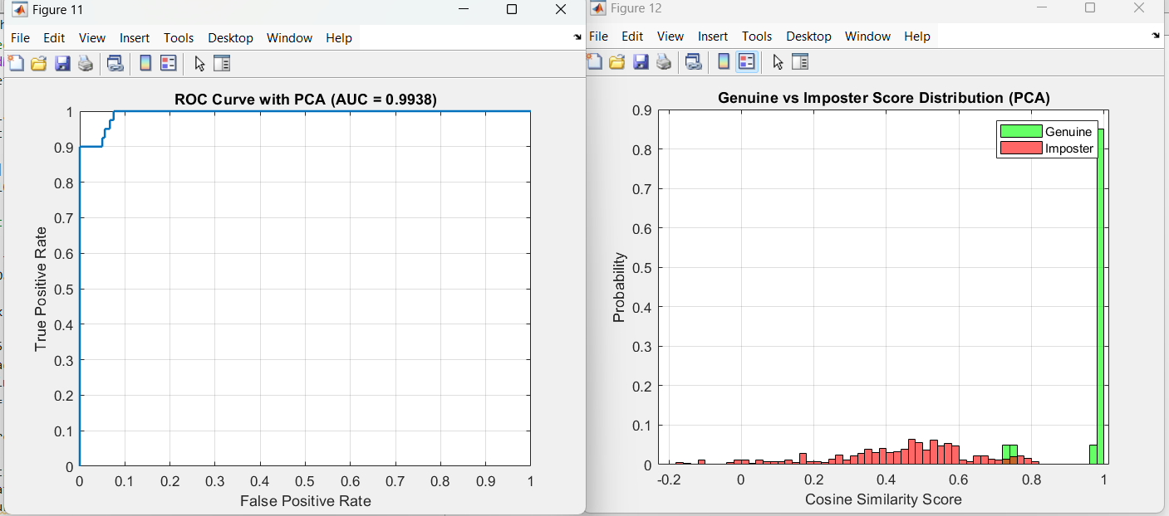
ROC curve and distribution histograms for model 4A after PCA with 90% of accumulated variance

Slide 17
Models evaluation:
The aggregated model (from the top 3 individual models) achieved a d-prime of 3.8409, indicating good separability between genuine and imposter scores.
After applying PCA( retaining 90% of variance), the d-prime dropped to 3.4114 suggesting some performance loss.
Model 4A achieved 100% accuracy and the highest d-prime of 4.4494, outperforming both the aggregated model and other individual models.
Even after PCA, performance remained strong, with d-prime of 4.1918 .

Slide 18
Generalization Evaluation: Training on 40 Subjects, Testing on 10
To assess the model’s ability to generalize beyond the training data, we trained AlexNet three times using only 40 subjects from the AT&T dataset. Each training run used a different set of hyperparameters. The remaining 10 subjects were completely excluded from the training process and used exclusively for testing. All three models trained on the 40-subject set achieved validation accuracy above 90%, and were therefore kept. Their weights were averaged to produce a single aggregated model aimed at generalizing to unseen identities.
The training evolution of these three models is shown below. Each plot represents the accuracy and loss progression during training, providing insight into model stability and convergence behavior.

Slide 19
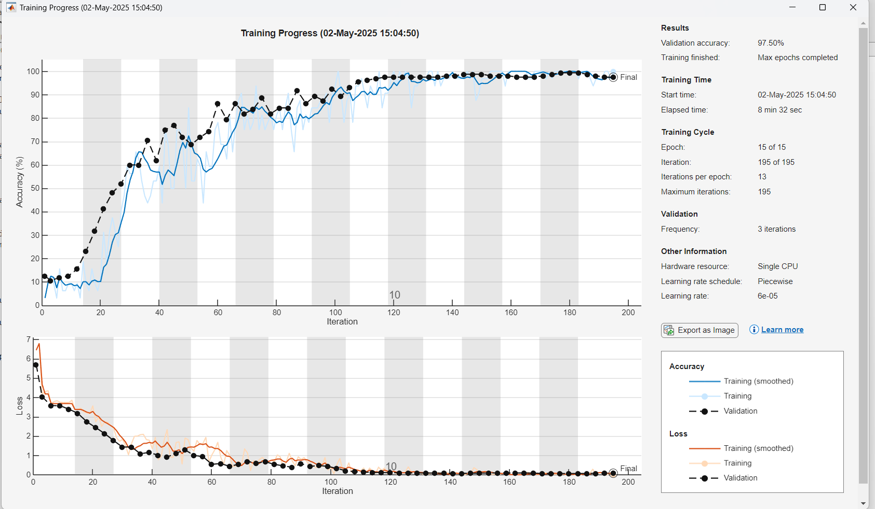
Training loss and accuracy for Model 1B

Slide 20
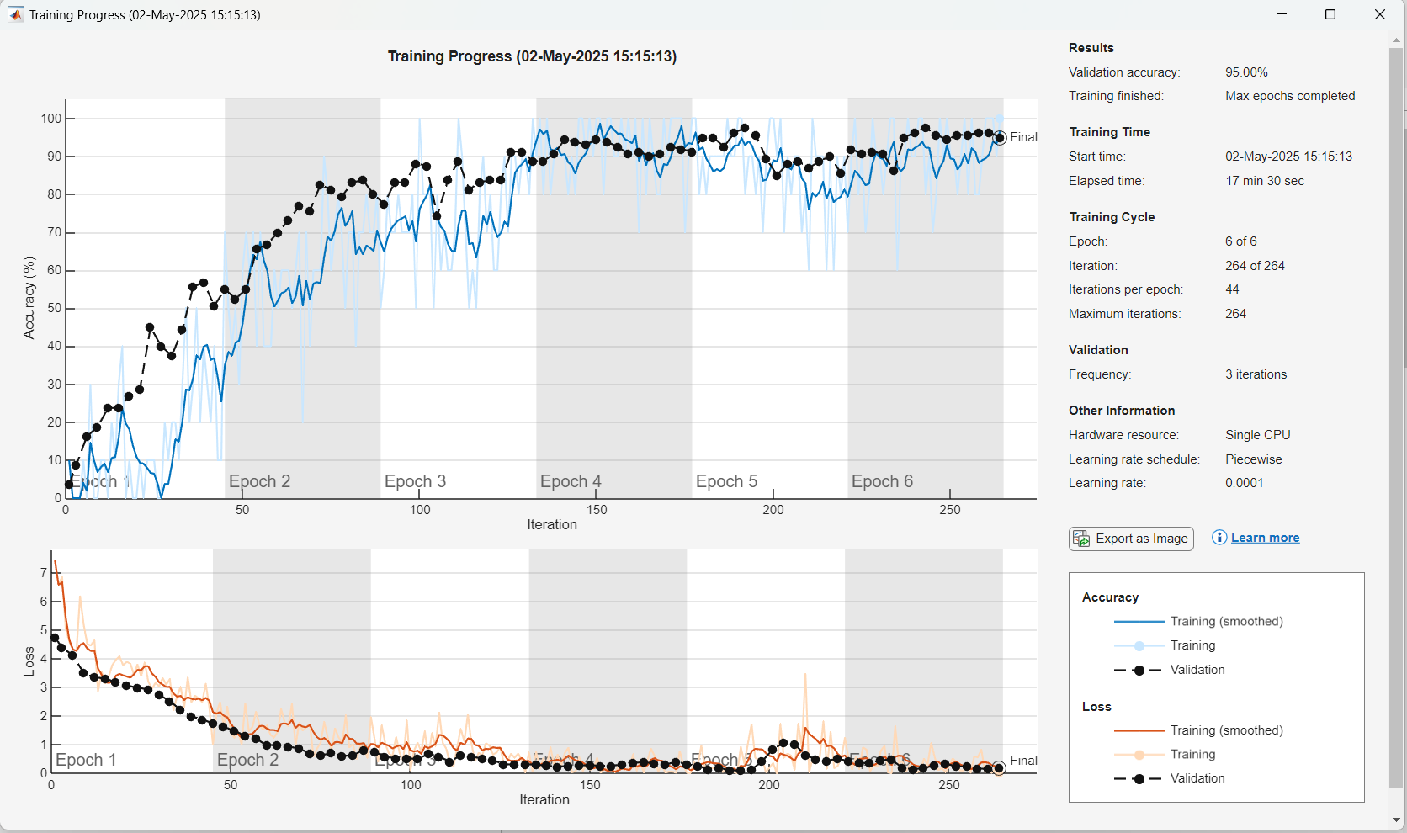
Training loss and accuracy for Model 2B

Slide 21
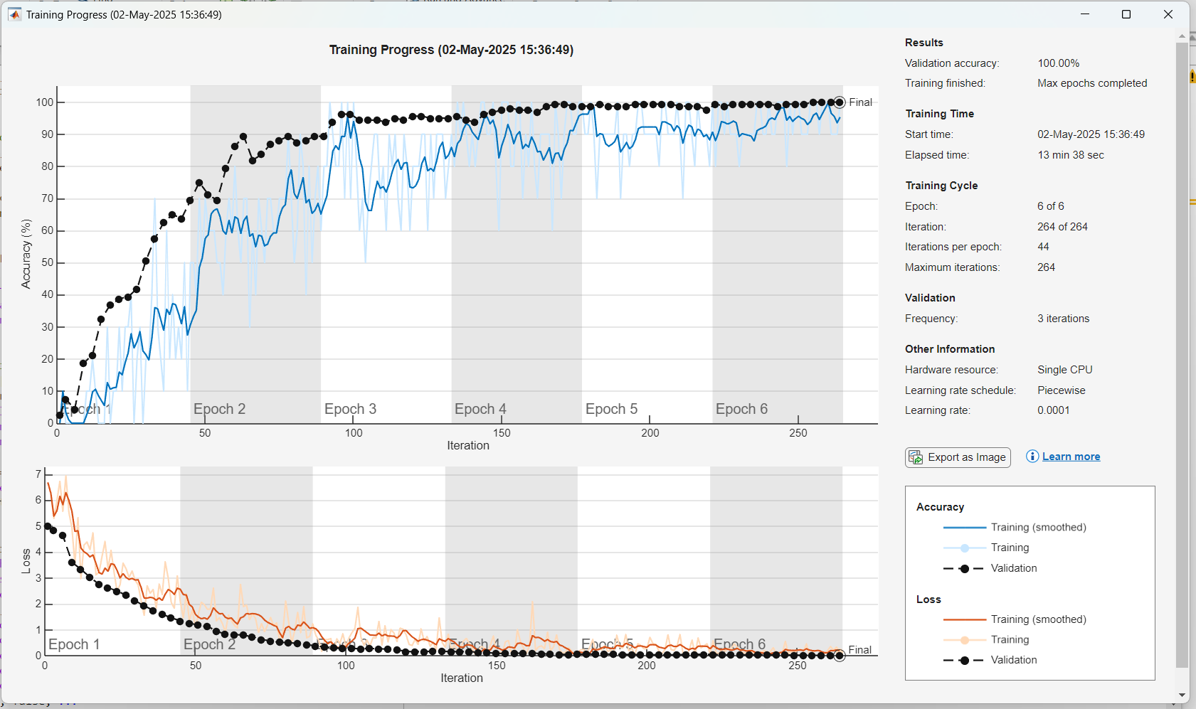
Training loss and accuracy for Model 3B

Slide 22
Evaluation on Unseen Subjects
The same evaluation protocol used in the first phase was applied here. Feature vectors were extracted by removing the classification layer, and cosine similarity was computed between probe and gallery images for the 10 unseen subjects. The aggregated model and individual models were then evaluated using ROC curves and similarity score distributions.

Slide 23
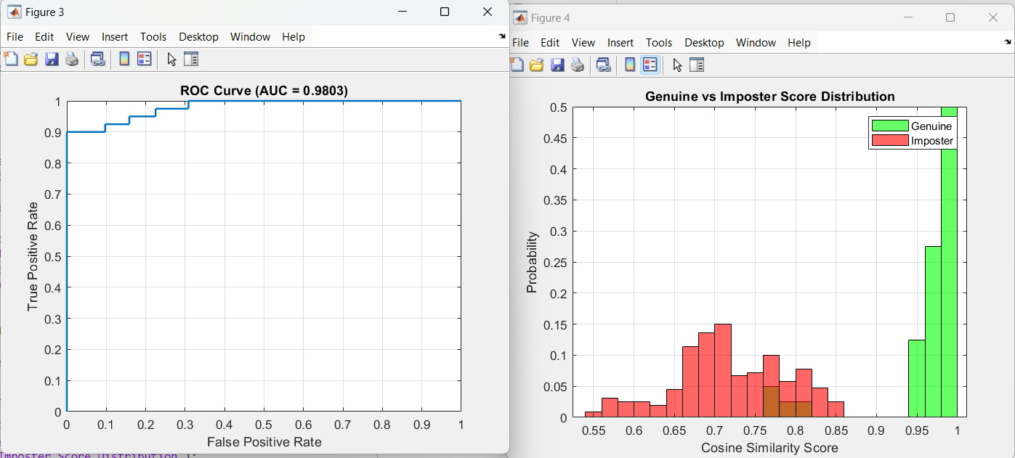
ROC curve and distribution histograms for the aggregated model B

Slide 24
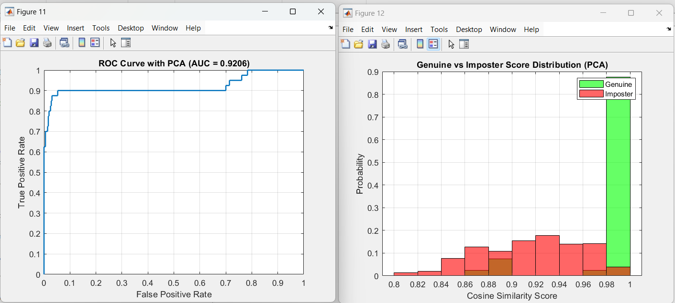
ROC curve and distribution histograms for the aggregated model B after PCA with 90% of accumulated variance

Slide 25
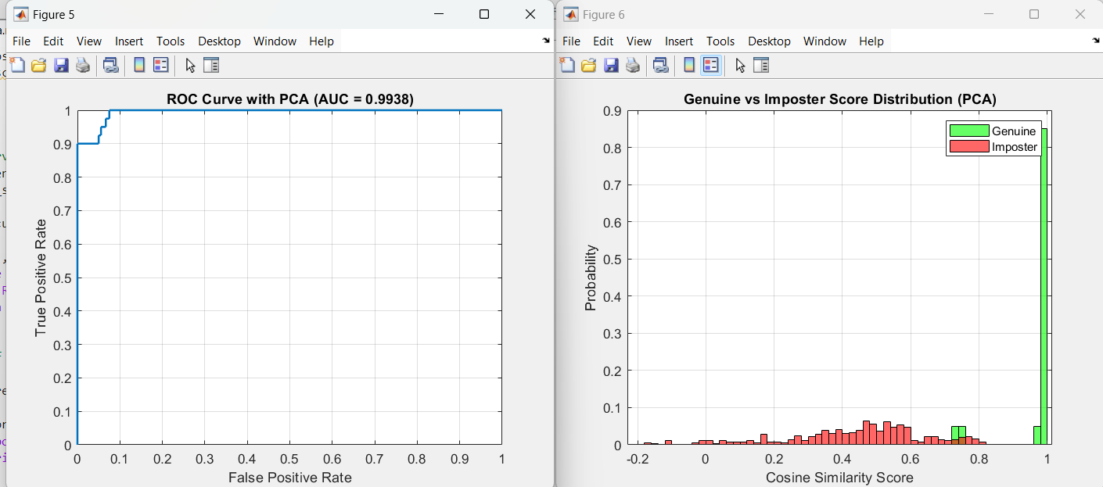
ROC curve and distribution histograms for the aggregated model 3B

Slide 26
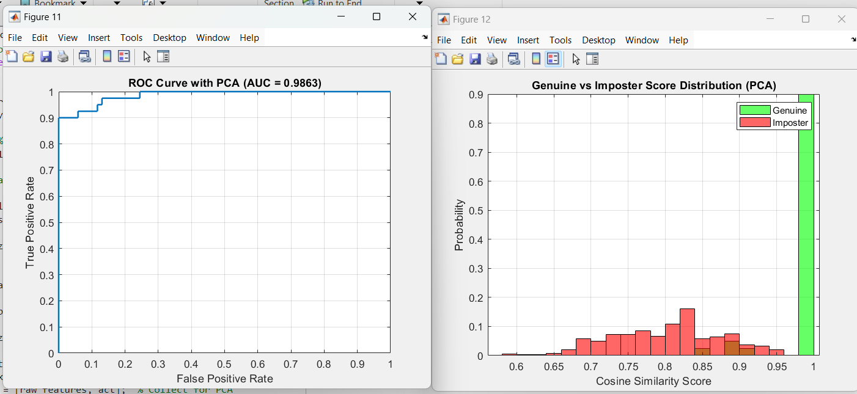
ROC curve and distribution histograms for the aggregated model 5B after PCA with 90% of accumulated variance

Slide 27
Recognition Performance on Unseen Subjects
Model B (the aggregated model) achieved a d-prime of 3.7432, which decreased to 3.09 after applying PCA. Interestingly, Model 3B achieved 100% accuracy on the test set with a d-prime of 3.06, and its performance actually improved after PCA, reaching 3.61.
While both models performed well, neither surpassed the results of Model 2 from the first phase (Model 4A), which achieved 100% accuracy and the highest d-prime (4.4494). Based on this, Model 4A was selected as the final model for the ranking stage.

Slide 28
Ranking Evaluation
To further assess the performance of the final selected model (Model 4A), a ranking experiment was conducted. For each subject, one image was used as a probe, and compared against a gallery composed of all other images from the dataset — excluding the probe itself. The cosine similarity between the probe and every gallery image was calculated, and the results were sorted in descending order.
A similarity threshold of 0.9612 was established based on the maximum true positive rate (TPR) with a false positive rate (FPR) of zero, derived from the ROC curve of Model 4A. This threshold was used to define successful identification across different ranking levels
A match was considered Rank 1 if the top-ranked image belonged to the same subject and exceeded the threshold.
If the correct subject appeared within the top two results, it counted as Rank 2.
If it appeared within the top three, it was considered Rank 3.

Slide 29
The model achieved 100% identification accuracy at Rank 1, indicating that the correct subject was always the highest-ranked match, and well above the similarity threshold. No errors occurred even at the strictest ranking level
To further evaluate the model's identification performance, we computed the Cumulative Match Characteristic (CMC) curve. The CMC curve measures the likelihood that the correct identity appears within the top k matches

Slide 30
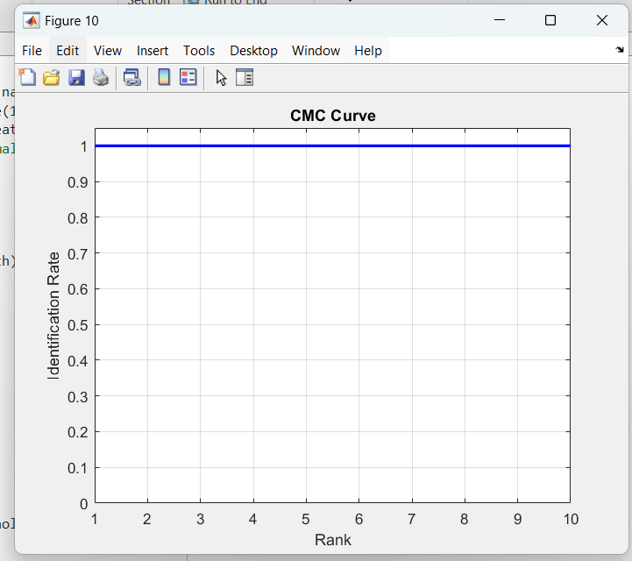
CMC curve for Model 4A

